Slide 1
Advanced Computer Architecture
Histogram - GPU
Notes:
Morgan Kaufmann Publishers
Chapter 1 — Computer Abstractions and Technology

Slide 2
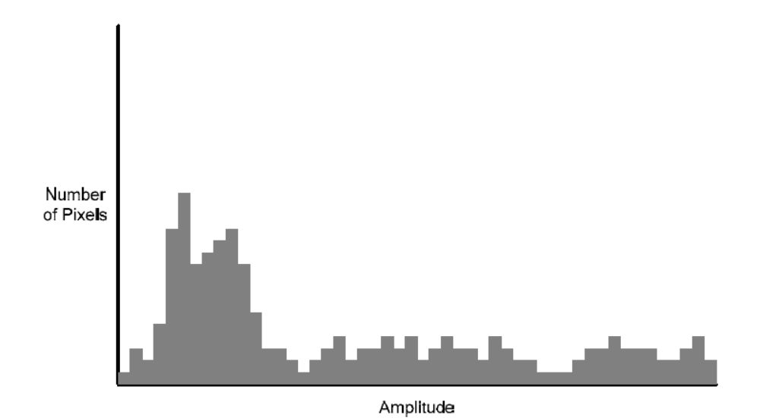
Histogram
Given an image (or data array) calculate this:
Distribution of values

Slide 3
Sequential Algorithm
for (int i = 0; i < BIN_COUNT; i++)
result[i] = 0;
for (int i = 0; i < dataN; i++)
result[data[i]]++;

Slide 4
Parallel Strategy
Distribute work across multiple blocks
  Divide input data to blocks
Each block process a portion of the data
  Two Options:
    Multiple threads: one thread per data value
    Multiple elements per thread
      Two variations: arrangement of threads: stride & contiguous
  Both options produce a partial histogram
    Could produce multiple histograms
Merge all partial histograms
  Produces the final histogram

Slide 5
Number of Elements: One Thread per Element
How to deal with a generic number of elements?
  Maximum number of blocks = 65536
  Max number of threads per block = 512
Limit N to 33Million
  However, not an effective way to combine results
  Each thread needs to update global histogram array

Slide 6
Multiple Elements Per Thread: Stride
General kernel format: adding elements (reduce)
#define N 1024
__global__ void kernel( int *d_in, int *d_out, int N) {
int tid = threadIdx.x + blockIdx.x * blockDim.x;
int sum = 0;
int THREAD_N = blockDim.x * gridDim.x;
for (int opt=tid; opt < N; opt = opt + THREAD_N) {
sum = sum + d_in[opt];
}
d_out[tid] = sum;
}
kernel <<< 2, 32>>> (d_in, d_out, N);
// Launching 2 blocks of 32 threads
// d_in has 1024 elements
// d_out has 64 elements to reduce partial sums
// 64 total threads, each thread processes 16 items
N prevents threads from going beyond data size
tid
THREAD_N
N
THREAD_N = the number of blocks times the block size, represents the offset to the next item to be processed
d_in
Block0
Block1
Block0
Block1

Slide 7
Multiple Elements Per Thread: Contiguous
General kernel format: adding elements (reduce)
#define N 1024
__global__ void kernel( int *d_in, int *d_out, int N) {
int tid = threadIdx.x + blockIdx.x * blockDim.x;
int sum = 0;
int THREAD_N = blockDim.x * gridDim.x;
for (int opt=tid*THREAD_N; opt < N/(THREAD_N); opt = opt + 1) {
sum = sum + d_in[opt];
}
d_out[tid] = sum;
}
kernel <<< 2, 32>>> (d_in, d_out, N);
// Launching 2 blocks of 32 threads
// d_in has 1024 elements
// d_out has 64 elements to reduce partial sums
// 64 total threads, each thread processes 16 items
Block0
Block0
Block0
Block0
tid==0
tid==1
tid==2
tid==3
N
Each thread handles a contiguous region of the input data array
d_in

Slide 8
Solving Histogram (Without Atomics): Sub-Histograms
How many sub-histograms can we fit in shared memory?
  Input value range: 0-63
  Each histogram needs 64 entries
If 32 threads per block, each block would require
  32*64 entries of shared memory

Slide 9
Algorithm Overview
Kernel1 “Generate Partial Histograms”
  Initialize partial histogram of each thread
  Each thread set their own:
    s_Hist[0…63] = 0
  Update histogram
  Each thread:
    Write out s_Hist to partial histogram in global
  Summary each thread generates 1 partial histogram
Kernel2 “Merge”: 1 block per each histogram value will perform a reduction to global histogram
  Each thread: Update global histogram (each block controls one histogram entry, but can be carried out with multiple threads)
    Repeat across all partial histograms
      Read partial histogram[index]
      Update global histogram

Slide 10
Generate Kernel
#define HISTOGRAM64_THREADBLOCK_SIZE 32
#define HISTOGRAM64_BIN_COUNT 64
__global__ void histogram64Kernel(uint *d_PartialHistograms, data_t *d_Data, uint dataCount){
__shared__ int s_Hist[HISTOGRAM64_THREADBLOCK_SIZE * HISTOGRAM64_BIN_COUNT];
int tid = threadIdx.x + blockIdx.x * blockDim.x;
for(int i = 0; i < HISTOGRAM64_BIN_COUNT; i++)
s_Hist[threadIdx.x* HISTOGRAM64_THREADBLOCK_SIZE +i] = 0;
int THREAD_N = blockDim.x * gridDim.x;
for (int pos=tid; pos < dataCount; pos = pos + THREAD_N) {
int data = d_Data[pos];
s_Hist[data+theadIdx.x*HISTOGRAM64_BIN_COUNT] += 1;
}
__syncthreads();
for(int i = 0; i < HISTOGRAM64_BIN_COUNT; i++)
d_PartialHistograms[tid*HISTOGRAM64_BIN_COUNT + i] =
s_Hist[threadIdx.x*HISTOGRAM64_THREADBLOCK_SIZE +i];
}
histogram64Kernel<<<histogramCount, HISTOGRAM64_THREADBLOCK_SIZE>>>
// histogramCount calculated by dataCount / HISTOGRAM64_THREADBLOCK_SIZE
// d_PartialHistograms- allocate histogramCount * HISTOGRAM64_BIN_COUNT

Slide 11
Merge Kernel
#define MERGE_THREADBLOCK_SIZE 32
#define HISTOGRAM64_BIN_COUNT 64
__global__ void mergeHistogram64Kernel(
uint *d_Histogram,
uint *d_PartialHistograms,
uint histogramCount)
{
__shared__ uint data[MERGE_THREADBLOCK_SIZE];
uint sum = 0;
for(uint i = threadIdx.x; i < histogramCount; i += MERGE_THREADBLOCK_SIZE)
sum += d_PartialHistograms[blockIdx.x + i * HISTOGRAM64_BIN_COUNT];
data[threadIdx.x] = sum;
for(uint stride = MERGE_THREADBLOCK_SIZE / 2; stride > 0; stride >>= 1){
__syncthreads();
if(threadIdx.x < stride)
data[threadIdx.x] += data[threadIdx.x + stride];
}
if(threadIdx.x == 0)
d_Histogram[blockIdx.x] = data[0];
}
histogramCount – number of partial histograms
Reduce threads of each block to 1
Example: blockIdx.x == 0, sums all partial histograms positions 0
d_PartialHistograms[0], d_PartialHistograms[64], d_PartialHistograms[128]
all correspond to histogram position for value “0”

Slide 12
Merge Kernel - launch
#define MERGE_THREADBLOCK_SIZE 32
#define HISTOGRAM64_BIN_COUNT 64
__global__ void mergeHistogram64Kernel(
uint *d_Histogram,
uint *d_PartialHistograms,
uint histogramCount)
{
__shared__ uint data[MERGE_THREADBLOCK_SIZE];
uint sum = 0;
for(uint i = threadIdx.x; i < histogramCount; i += MERGE_THREADBLOCK_SIZE)
sum += d_PartialHistograms[blockIdx.x + i * HISTOGRAM64_BIN_COUNT];
data[threadIdx.x] = sum;
for(uint stride = MERGE_THREADBLOCK_SIZE / 2; stride > 0; stride >>= 1){
__syncthreads();
if(threadIdx.x < stride)
data[threadIdx.x] += data[threadIdx.x + stride];
}
if(threadIdx.x == 0)
d_Histogram[blockIdx.x] = data[0];
}
mergeHistogram64Kernel<<<HISTOGRAM64_BIN_COUNT, MERGE_THREADBLOCK_SIZE>>>(
d_Histogram, d_PartialHistograms, histogramCount
);

Slide 13
Atomic Operations
Read-Modify-Write operations that are guaranteed to happen “atomically”
  Produces the same result as if the sequence executed in isolation in time
  Think of it as “serializing the execution” of all atomics

Slide 14
atomicAdd,
atomicAdd (pointer, value)
  tmp = *pointer
  *pointer = *pointer + value
  return tmp
Replace second kernel with atomicAdd in the first kernel (add to single global position for each value)

